Slide 1
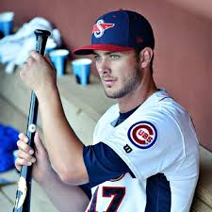
Who should a Baseball GM draft?
Anna Bell Lansdowne

Slide 2
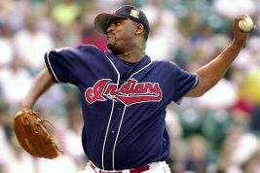
Reasons From the Past That A Scout Wouldn’t Recommend Drafting a Player
A weak handshake
Small hands
Square Shoulders
Hitting and Throwing With the Opposite Hand
Duck Feet
A “spongecake” physique
“There's a long-held notion that a mousy-looking player has been so beaten down by an inability to get dates in high school that he might lack the self-esteem to succeed in pro ball.”
http://www.espn.com/mlb/story/_/id/9319990/draft-eligible-players-how-scouts-percieve-their-shortcomings

Slide 3
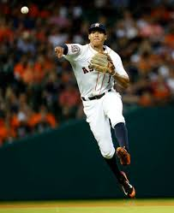
Is it more beneficial to draft a pitcher or a big bat with your first pick?
In the past 5 years, 3 position players have been taken first and 2 pitchers have been taken first
2016 – Mickey Moniak – OF
2015 – Dansby Swanson – SS
2014 – Brady Aiken – LHP
2013 – Mark Appel – RHP
2012 – Carlos Correa – SS
Is a team more likely to find a Kris Bryant of a Stephen Strasburg with the 1st pick? And who is more likely to bring a championship to the organization?

Slide 4
Assuming
Picks are from the June Amateur Draft not the Rule V draft
The ultimate goal of a GM is to win the world series
Not increase ticket sales
A player is drafted to play on that team, not to be traded
Intangibles are not considered
A team could use a bat or an arm
The drafted player will sign (Mark Appel was actually drafted in 2012 by the Pirates but did not sign)

Slide 5
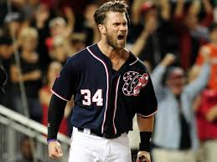
Data
MLB Draft History: MLB.com
MLB Player Stats: baseball-reference.com

Slide 6
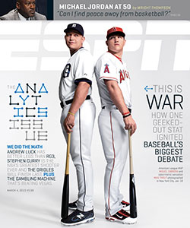
Stat to Look At
WAR
Wins Above Replacement
bWar
Because WAR does not have a specific calculation, bWAR is the WAR calculated by baseball reference
WAR can be compared between pitchers and field players
“WAR values are scaled equally for pitchers and batters; that is, pitchers and position players will have roughly the same WAR if their contribution to their team is deemed similar.”
Harder to compare batting average vs. ERA for example

Slide 7
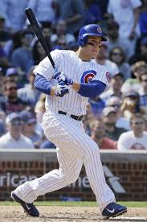
Things To Consider
If team is not in rebuild mode, who is more likely to get to the majors faster?
An easy stat to compare would be all-star game appearances, but does this constitute an impactful player?
Ernie Banks was an 11-time all-star but never won a World Series
Is it easier to acquire an impactful pitcher or position player via trade?
Is it more likely you find a good bat or a good arm in the later rounds?
Mark Buehrle was drafted in the 38th round and Mike Piazza (the greatest hitting catcher of all time!!!) was drafted in the 62nd round
I also want to look at World Series winning teams and the players they drafted the previous ~5 years before

Slide 8
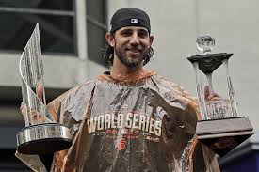
The Madison Bumgarner Effect
Baseball is usually a team sport
Madison Bumgarner (10th overall pick) almost single-handedly won the World Series for the Giants in 2014 when he threw 52 2/3 innings
Andrew Miller was one game away from doing the same thing this year
Should a baseball GM go out of his/her way to find the next MadBum

Slide 9
Should a GM pick a player from HS or College?
Going back to the past 5 picks, 3 have been from HS and 2 have been from college
2016 – Mickey Moniak – HS
2015 – Dansby Swanson – College
2014 – Brady Aiken – HS
2013 – Mark Appel – College
2012 – Carlos Correa – HS

